Slide 1

Fault Localization of Loop Network Devices based on MEC Platform
Qi Zhang、Xueqin Lin
-- GuoChuang ChapterIX
Notes:
Hello everyone, my name is qi zhang and I come from guochuang chapterix and my presentation topic is Fault Localization of Loop Network Devices based on MEC Platform

Slide 2
01
Question descriptions
02
Question analyzations
Directory
03
Architecture design
04
Summary
Notes:
my presentation will follow this structure

Slide 3
PART 1
Question
descriptions

Slide 4
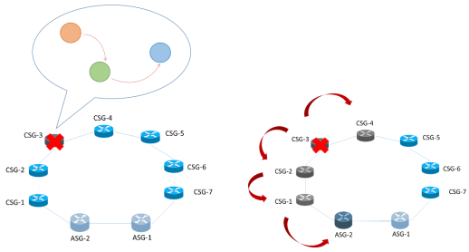
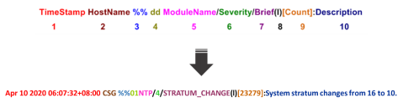
Fault Localization of Loop Network Devices
Alarm logs：
The logs is about the MEC(Multi-access Edge Computing) which is a kind of communication cloud. In order to improve MEC operation ability, there should have some methods, such as rapid discovery, positioning, prediction, self-healing, etc.
Original data
The alarm log is unstructured text information, contains log level (level 8), module, details, etc..
Notes:
This topic is the subject of a competition, about the MEC platform . For this topic, there are two type data include the topology and alarm logs. Alarm log is the text information, every line contains level, time description and so on . In topology, each device connect with each other.

Slide 5
PART 2
Question
analyzations

Slide 6
Fault Localization of Loop Network Devices
Alarm data analyzation
Delivery network determination
Root alarm
determination
Deal with the alarm log and extract some useful information
determine and draw the alarm transmission network
determine the root alarm and subordinate alarm
Notes:
For the whole topic, first we need extract useful information from the original data. And then, use the alarm data to draw the transmission network. And finally, according to the topology, determine the root alarm, subordinate alarm.

Slide 7
PART 3
Architecture
design

Slide 8
Architecture
Fifth
Result output
Fourth
Network topology
Third
association analysis
Second
Time window division
First
Alarm preprocessing
Notes:
The architecture includes five parts.

Slide 9
Alarm preprocessing
Extract information
Add brief name
Eliminate alarm
using regularization rules → standard data.
Add year information.
Deal with some incomplete data
Use natural language processing
Extract the first five keywords
Regularization method
Delete duplicate alarms
Delete the high frequency data
Delete low level alarm
Notes:
For the preprocessing, firstly, extract useful information, by some regularization rules. Also, we add the year information and deal with incomplete data.
Second, adding brief name. in the original alarm the description is so long that we cannot classify the alarm type. Therefore, we add the brief instead of description.
Lastly, we delete some duplicate alarms. Low level alarm.

Slide 10
Time window planning
Neighbors
time window
Add own neighbors to each device
The interval of time window is set to 1 minutes
Frequent items
Get frequent items from time window
sliding step
Slide one alarm at a window time
Notes:
The sliding step is one alarm. Is means that every time, when it finishes processing one time window, it will move one alarm and process a new time window.
Lastly, we can get the frequency items with the score .

Slide 11
Association analysis
Traditional Eclat algorithm:
Generate all subsets
Takes up a lot of memory
Waste running time
Have no any direction for each pair alarm
{A, B} and {B, A} are the same frequent terms.
Our method:
Device neighbors :
The alarms will spread through the adjacent equipment
Set adjacent equipment as neighbors for each device
Special Eclat algorithm :
Do not generate subsets, and directly generate the probability/score that forward item leads to backward item.
Just calculate the score between items and their neighbor
Advantages:
Ensure the sequence between alarms
Reduce running time and memory
Notes:
Also, we change the eclat algorithm. In the traditional algorithm, it will generate all subsets which will takes up a lot of memory. Also, it has no any direction for each pair alarm.
In our method:
With the device neighbors and special eclat algorithm, we can just generate the score that forward item leads to backward item.
Therefore, it ensure the sequence between alarms and reduce the running time and memery
In a single break, devices A and B are adjacent. If device a will send an alarm about the port down, and device B will also send corresponding alarm;
Equipment A, B and C are adjacent, when equipment B is lost, both equipment A and C will send alarm at the same time.

Slide 12
Subordinate alarm
Drawing the network topology by the relation rule
network topology
Highest score is the root alarm
Locates the alarm on original data
root device
With time window, find the subordinate alarm, equipment, etc..
Calculate input radio
Additional rate:
1> alarm level
2> port relationship
subordinate equipment
node score
CSG-8&VFS&MIB_OPERATE_PUT_FILE => CSG-8&HWCM&CFGCHANGE
Notes:
After getting the associate rules, we can draw the alarm network topology and calculate the score of each node. The node with highest score is root alarm. Finally we can locates this alarm in original data. And combining root alarm and time window , we also can find the subordinate alarm, equipment and so on.

Slide 13
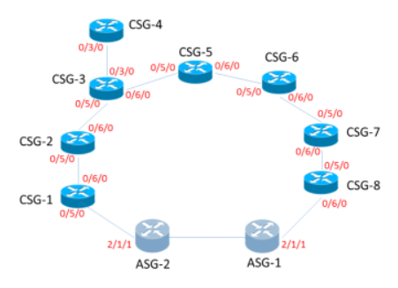
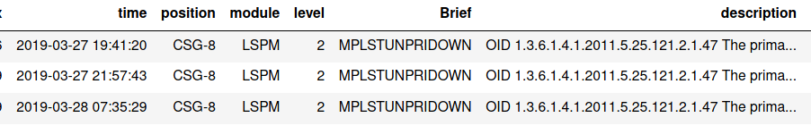
The results are showed that:
A-dataset:
The root node obtained is CSG-8
Subordinate nodes are ASG-1 and CSG-7.
Verify these nodes with answer and check the interface flow in the data set.
Therefore, the port of CSG-8 is down.
Notes:
For dataset a, the root device is CSG_8 and the subordinate device is ASG-1 and CSG-7. it means that port of CSG-8 is down. Also we verify the our result with the official answer , this is correct.

Slide 14
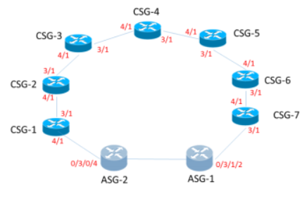
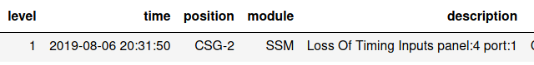
B-dataset:
The root node obtained is CSG-2
The subordinate nodes are CSG-3, CSG-4 , ASG-2.
Combined with topology, subordinate nodes, original
alarm logs.
CSG-1 does not have any current alarm.
CSG-1 equipment must be lost.
Notes:
For dataset b, the root device is CSG_2 and the subordinate device is CSG-3, CSG-4 , ASG-2. Combine with topology, the CSG-1 is the neighbor of CSG-2 and, ASG-2. and the CSG-1 do have any alarm logs, so we think the equipment CSG-1 is lost

Slide 15
PART 4
Summary

Slide 16
Feedback
What is the outstanding aspects :
Better adaptable
Just have some common preprocessing algorithm.
Eclat algorithm do not depend on business scenario.
Alarm association rule database
There are precise alarms relationship.
Alarm network propagation topology
Help to locate root fault accurately and fast.
Future work :
Add more data preprocessing methods.
Improve the calculating method of node score in the final stage.
Notes:
Our method has better adaptable because we just use the common preprocessing algorithm and the éclat algorithm do not depend on the business scenario
Also, we generate the alarm association rule database and the alarm network topology, with those, we can locate the root alarm fast
1. Based on the factors such as alarm level, alarm adjacent interval threshold, etc., the amount of alarm is compressed and the search range is reduced, which is helpful to improve the positioning accuracy of main alarm.
2. The alarm correlation space is constructed, and the alarm association rules are mined by improved association analysis Eclat algorithm, and the core alarm association rule base is established.
3. In order to improve the accuracy of the network, it is based on the relationship between the alarm and the storm, which is based on the network fault propagation rules.

Slide 17
Thank You
For listening
Qi Zhang | GuoChuang ChapterIX | Dec 2020

Slide 18
Reference:
[1] 陆斌，华楠，郑小平，等. 基于人工智能的网络告警关联分析处理的应用［J］. 邮电设计技术，2018（12）：1-6.
Lu Bin1 ，Hua Nan1 ，Zheng Xiaoping1 ，Chen Wenjun2 .Application of Network Alarm Association Analysis Processing Based on Artificial Intelligence[J].Intelligent Network,2018（12）：1-6.
[2]李金凤，王怀彬.基于关联规则的网络故障告警相关性分析[J].计 算 机 工 程,2012(3):44-46.
LI Jin-feng, WANG Huai-bin.Network Fault Alarm Correlation Analysis Based on Association Rule[J].Computer Engineering,2012(3):44-46.
[3]徐前方1 , 肖 波 2 , 郭 军 1.一种基于相关度统计的告警关联规则挖掘算法[J],北 京 邮 电 大 学 学 报,2007(2):66-70.
XU Qian-fang 1 , XIAO Bo 2 , GUO Jun 1,A Mining Algorithm with Alarm Association Rules Based on Statistical Correlation[J],Journal of Beijing Univ ersity of Posts and T elecommunications,2007(2):66-70.
Notes:
1. Based on the factors such as alarm level, alarm adjacent interval threshold, etc., the amount of alarm is compressed and the search range is reduced, which is helpful to improve the positioning accuracy of main alarm.
2. The alarm correlation space is constructed, and the alarm association rules are mined by improved association analysis Eclat algorithm, and the core alarm association rule base is established.
3. In order to improve the accuracy of the network, it is based on the relationship between the alarm and the storm, which is based on the network fault propagation rules.

